Slide 1



Phase-I Trigger Readout Electronics Upgrade for the ATLAS Liquid-Argon Calorimeters
TIPP17 –22 MAY 2017
Alessandra Camplani – Università degli Studi and INFN Milano
On behalf of the ATLAS Liquid Argon Calorimeter group

Slide 2
Outline
Introduction
LHC, ATLAS, LAr
Phase I Upgrade
LAr Front End Electronics
Baseplane, LSB
LTDB with custom ASICs
LAr Back End Electronics
Carrier and Latome
Demonstrator
Summary

Slide 3
Introduction

Slide 4
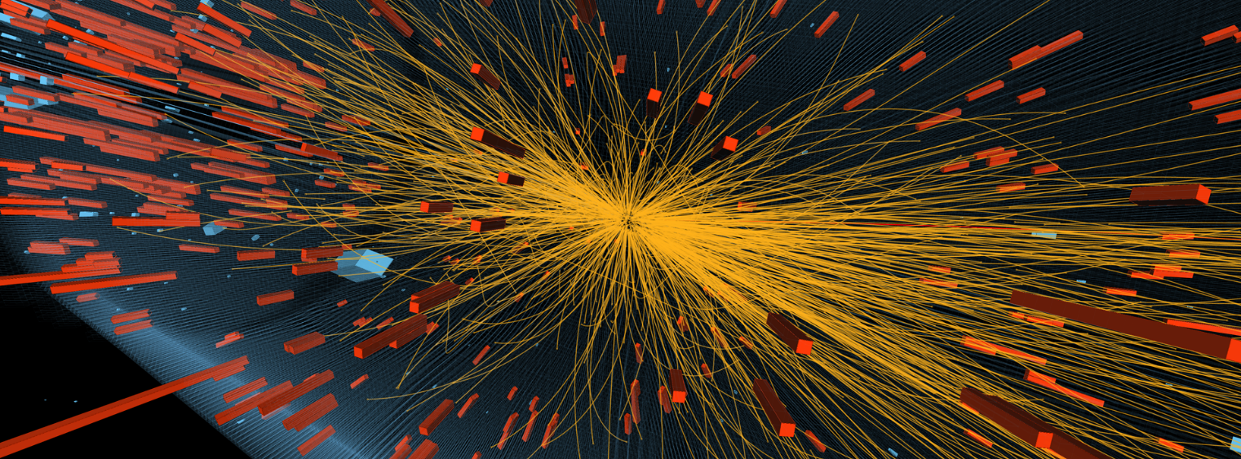
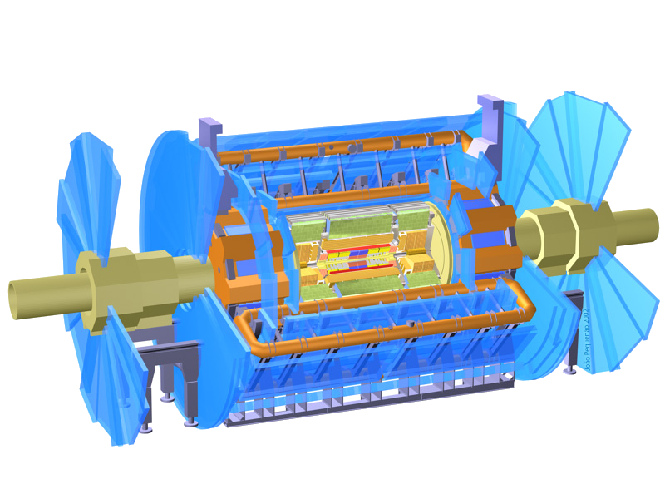
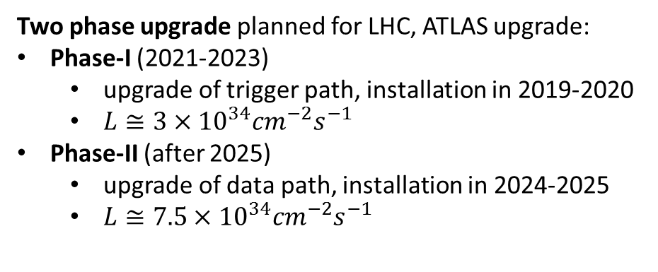
Context – LHC and ATLAS
Large Hadron Collider (LHC) at CERN, Geneva, Switzerland
27km circumference
depth between 50 to 175m
four collision points
A Toroidal LHC ApparatuS: ATLAS
46m long, 25m diameter and 7000 tons
Two phase upgrade planned for LHC, ATLAS upgrade:
Phase-I (2021-2023)
upgrade of trigger path, installation in 2019-2020
$L≅3×{10}^{34}{cm}^{−2}s^{−1}$
Phase-II (after 2025)
upgrade of data path, installation in 2024-2025
$L≅7.5×{10}^{34}{cm}^{−2}s^{−1}$
Purpose:
Answer fundamental physics questions about elementary particles and their interactions

Slide 5
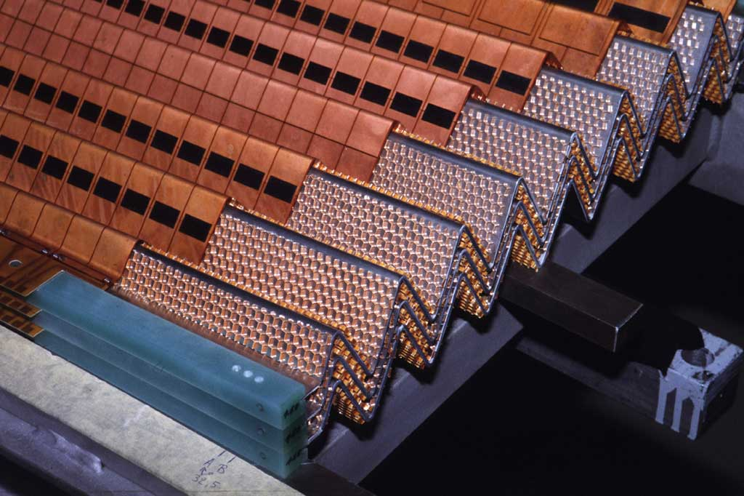
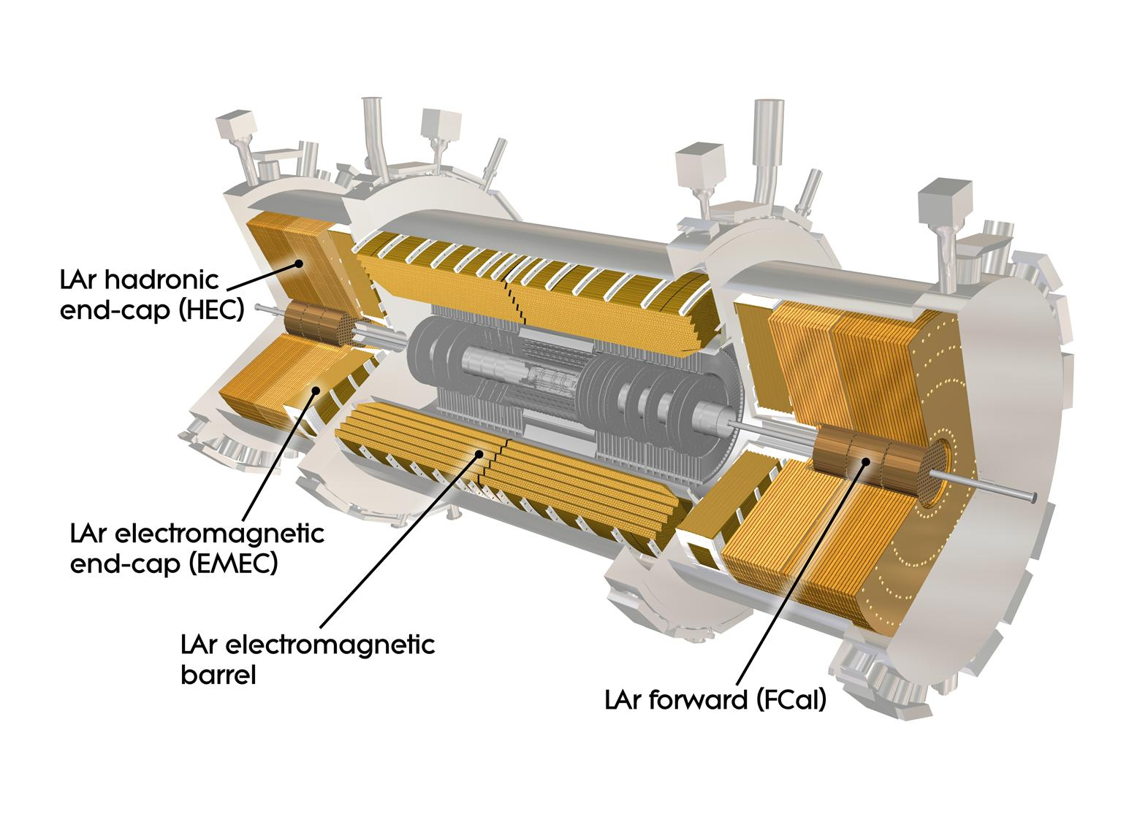
The Liquid Argon (LAr) Calorimeter
The LAr calorimeter is a sampling calorimeter with accordion-shaped lead absorbers, Liquid Argon as active material and copper-kapton electrodes.
180k channels for the full readout of the electromagnetic (EMB+EMEC), hadronic (HEC) and Forward (FCal) calorimeters
3k channels for analog Trigger readout
Front End crates: 1524 Front End Boards (FEB)
Back End crates: 192 Readout Out Driver boards (ROD)
LAr Calorimeter played a critical role for Higgs Boson discovery with two photons as a final state.
(EMB)

Slide 6
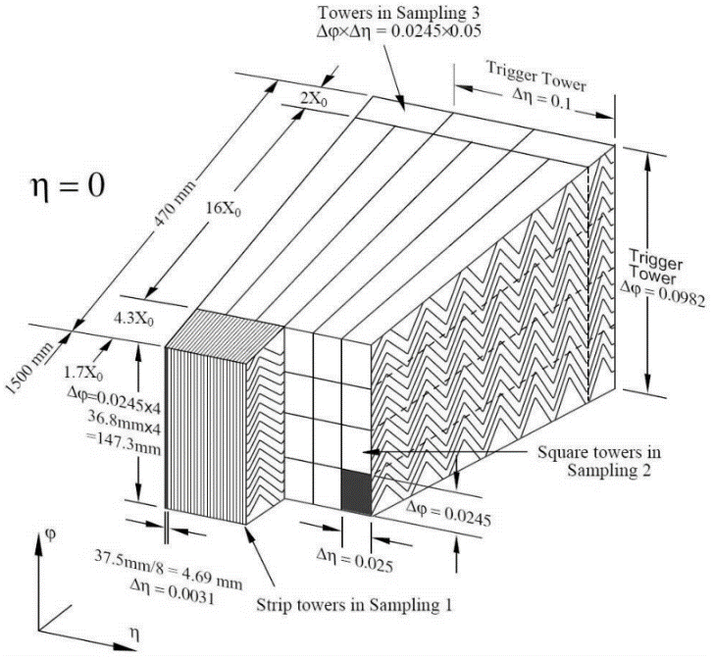
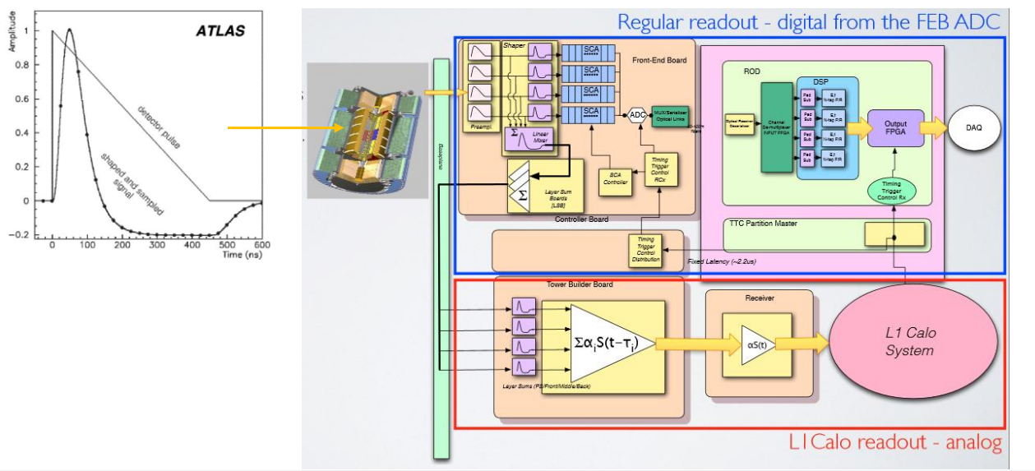
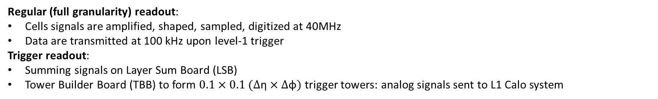
The current electronics
Regular (full granularity) readout:
Cells signals are amplified, shaped, sampled, digitized at 40MHz
Data are transmitted at 100 kHz upon level-1 trigger
Trigger readout:
Summing signals on Layer Sum Board (LSB)
Tower Builder Board (TBB) to form $0.1×0.1 (∆\text{η}×∆\text{φ})$ trigger towers: analog signals sent to L1 Calo system
Regular Readout
Trigger
Tower
Trigger Readout

Slide 7
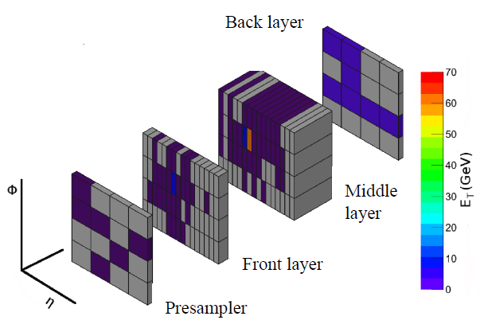
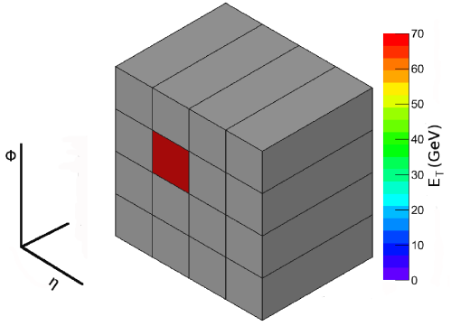
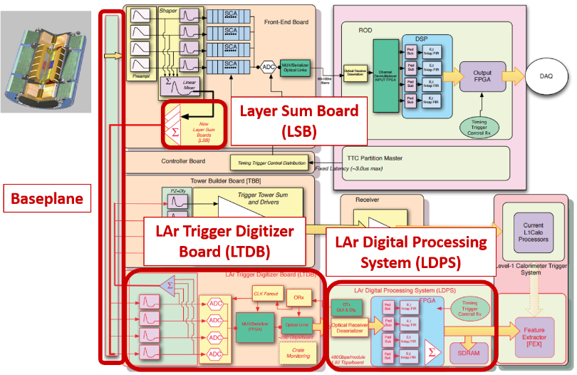
Calorimeter Upgrade
LAr Phase-I upgrade: new calorimeter trigger electronics with increased granularity and functionality for LAr calorimeter level 1 trigger
LAr Phase 1
Upgrade
Trigger Tower
Super Cells
Trigger Tower to Super Cells:
10 times granularity increase per each trigger tower
Information provided for each calorimeter layer for the full η range
Finer segmentation in the front and middle layers of the EM barrel and endcap
Higher resolution and shower information
New FE and BE electronics:
40 MHz digitization with 12 bit precion
Dense and high speed data transfer
Real time data processing with a fixed latency on FPGA
Deal with the luminosity increase, maintaining a low-pT lepton threshold and keeping the same trigger bandwidth with respect to Run2

Slide 8
Front-End (FE) Upgrade

Slide 9
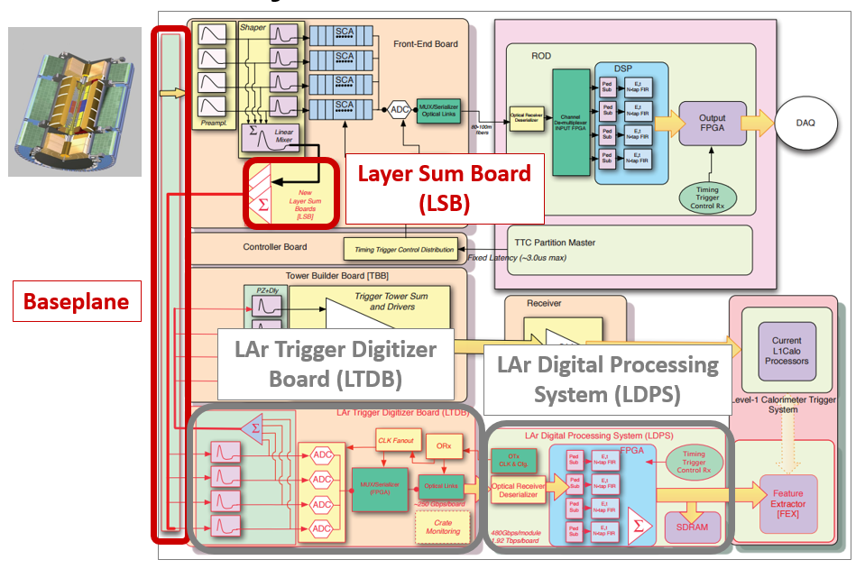
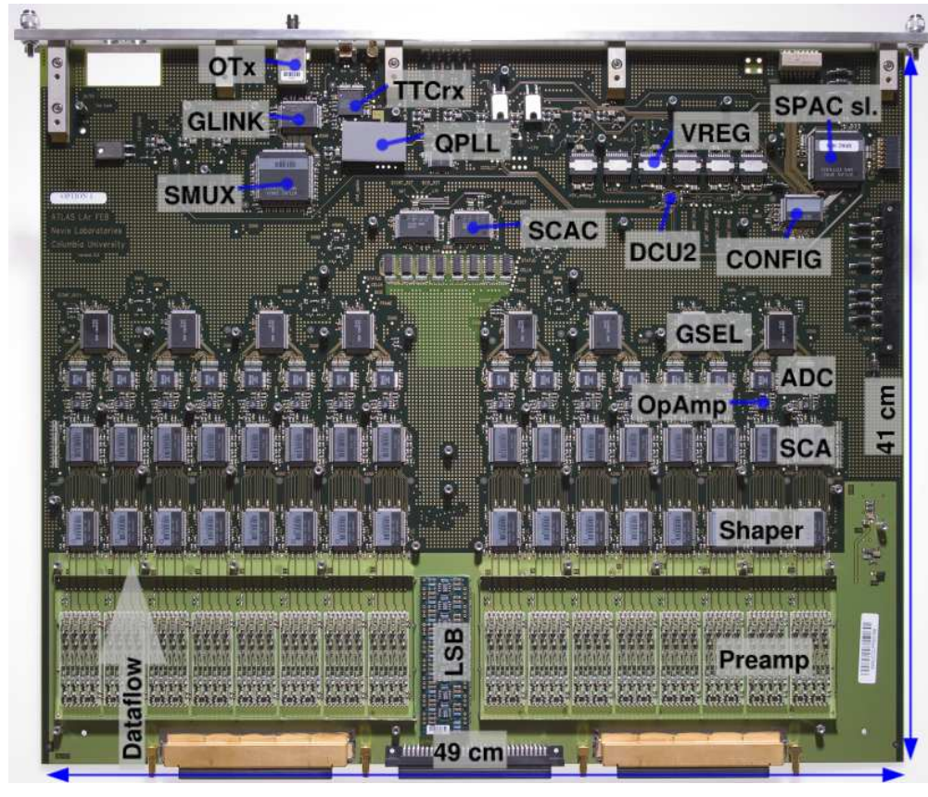
FE electronics components
New Layer Sum Boards (LSB) to perform analog sums for super cells
New Baseplane to keep compatibility with existing setup and route new SC signals
LAr Trigger Digitizer Boards (LTDB) with radiation-tolerant custom ASICs
ADC
Serializer (LOCx2)
Transmitter driver (LOCld)
FEB currently installed on the detector
Baseplane

Slide 10
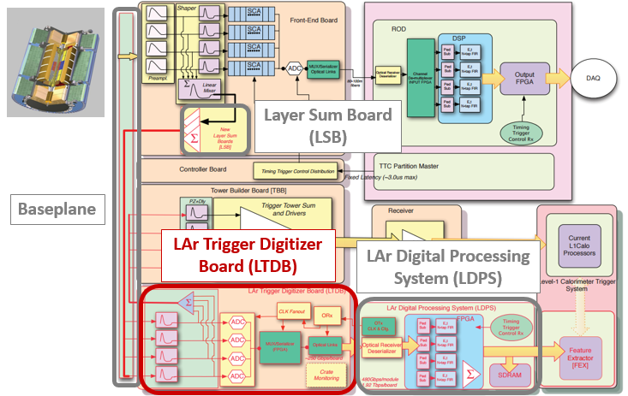
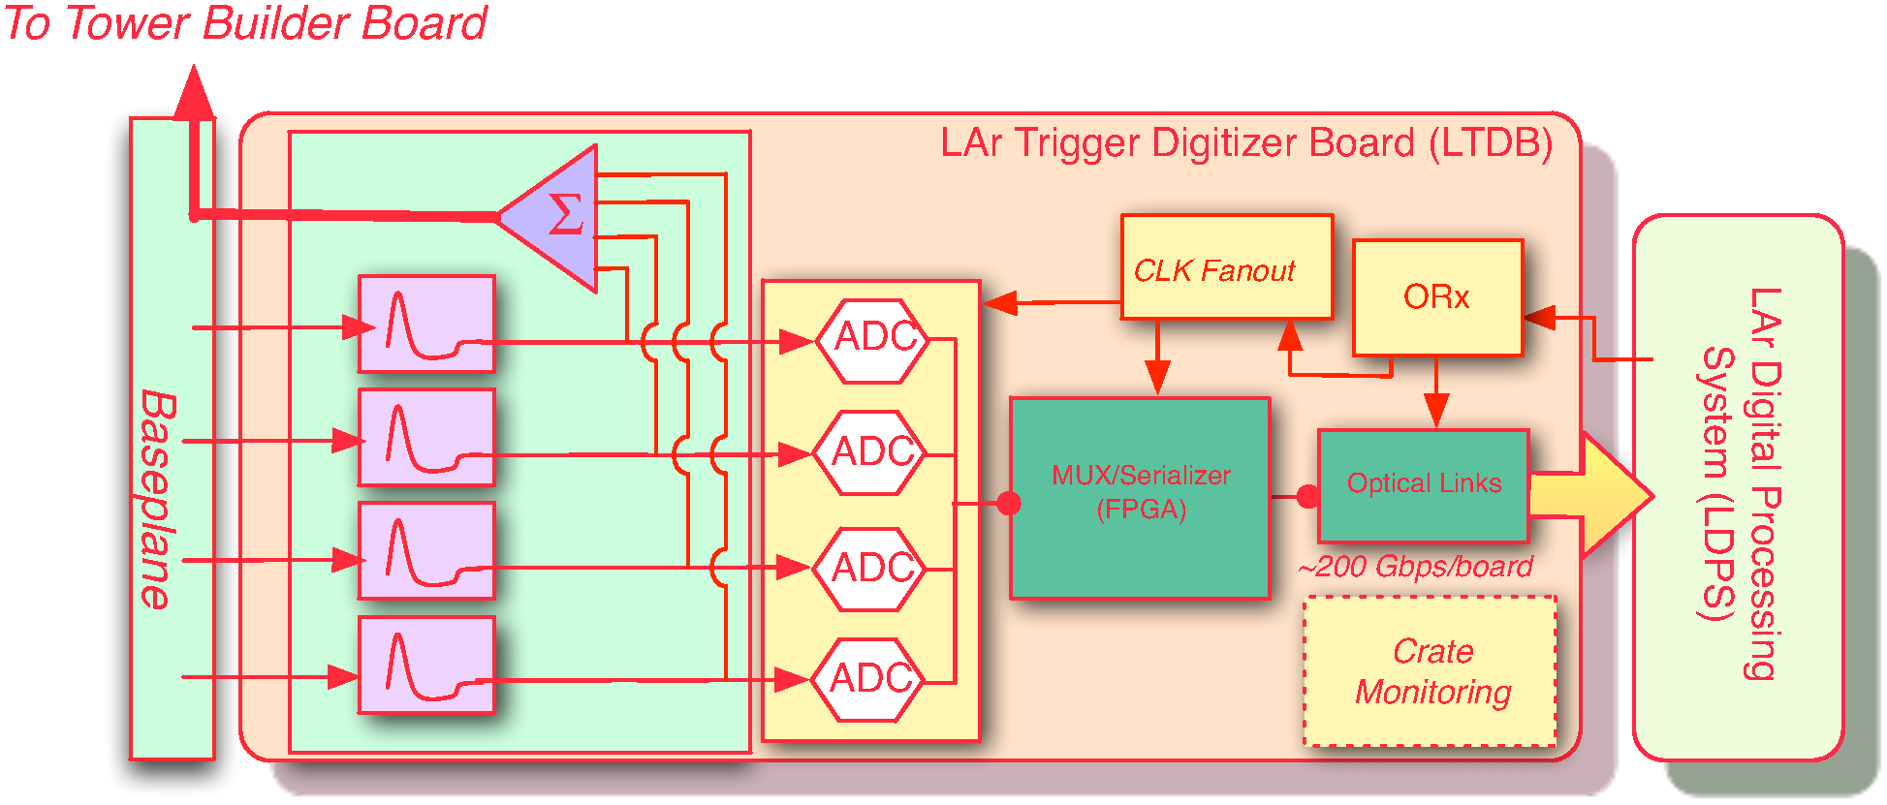
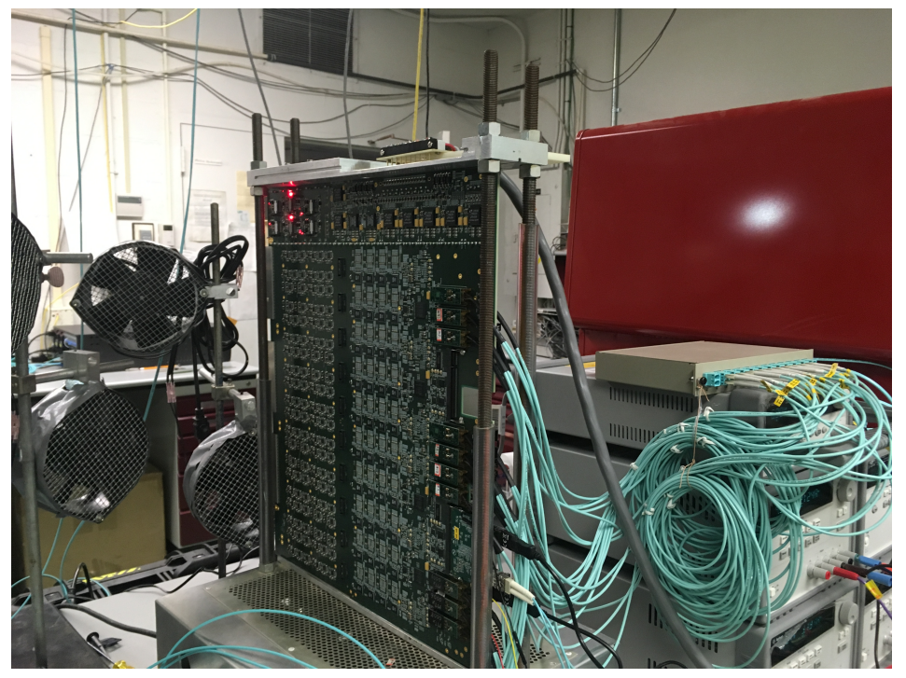
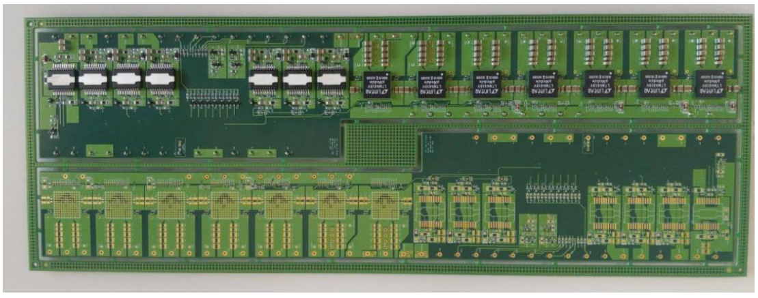
LAr Trigger Digitizer Board (LTDB)
124 LTDBs to readout the 34k Super Cells of the LAr calorimeter
1 LTDB handles analog input up to 320 Super Cells
Digitizes all analog signals at 12 bits @ 40MHz using 80 custom ADCs
Generate analog sums to keep compatibility with old system
Transmits digital signals using 40 optical links @ 5.12Gbps via custom ASICs
Receive LHC clock and Trigger signals through 5 GBTx links
Analog and Digital part are merged at the gerber file level
Power section is realized on a mezzanine (PDB)
Phase-II compatible
LTDB prototype
PDB

Slide 11
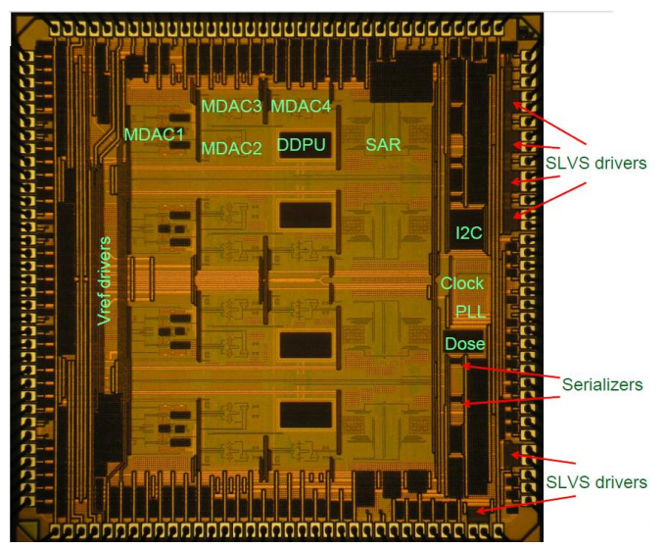
LTDB: custom ASICs (1)
ADC
Quad 12 bits hybrid pipeline SAR ADC (IBM8RF 130nm CMOS)
40 MSPS
ENOB 11 bits
Dynamic range
Typically 11.8 bits
Power dissipation < 50 mW/channel
112.5 ns latency
Die:
3.6 x 3.6 mm
72 pins QFN
Status
New test board is being developed to screen and categorize the production chips quickly
180 recently produced Nevis15 chips to develop and validate the QA/QC procedures
Radiation tolerance for Nevis ADC designs was established up to ~10 MRad (requirement of 100 kRad)

Slide 12
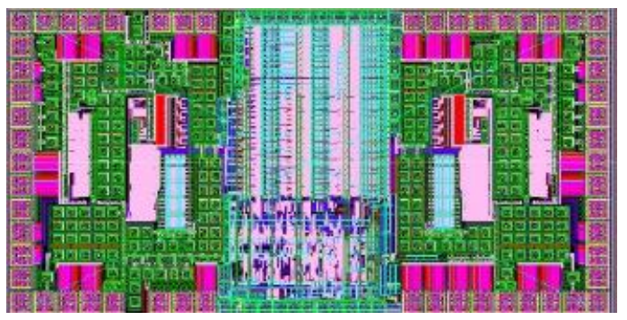
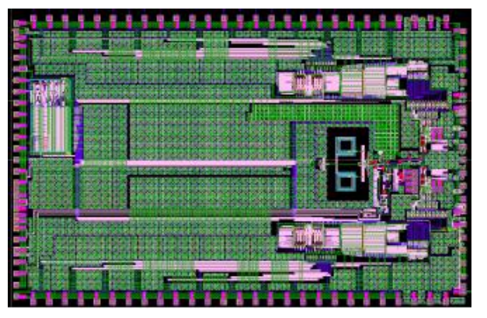
LTDB: custom ASICs (2)
LOCx2:
Silanna Foundry 250 nm, Silicon-on-Sapphire
DUAL 8 x 14 bits serializer
5.12 Gbps outputs
Nevis ADC compatible
Power consumption 1 W
Fixed Latency < 75 ns
Die:
6.036 x 3.68 mm
100 pins QFN
LOCld:
Dual channel VCSEL driver
Die:
2.114x1.090mm
40 pins QFN
Status:
The wafers of the baseline ASICs, LOCx2 and LOCld, have been produced and soon will be tested
Both ASICS radiation tolerant
Irradiated up to 200 krad
No change in the output eye diagram has been observed

Slide 13
Back-End (BE) Upgrade

Slide 14
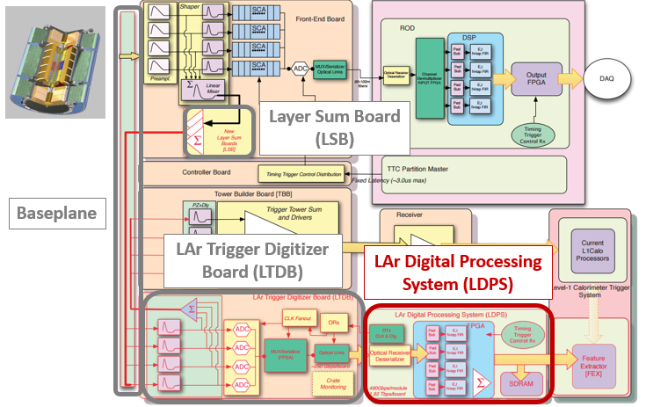
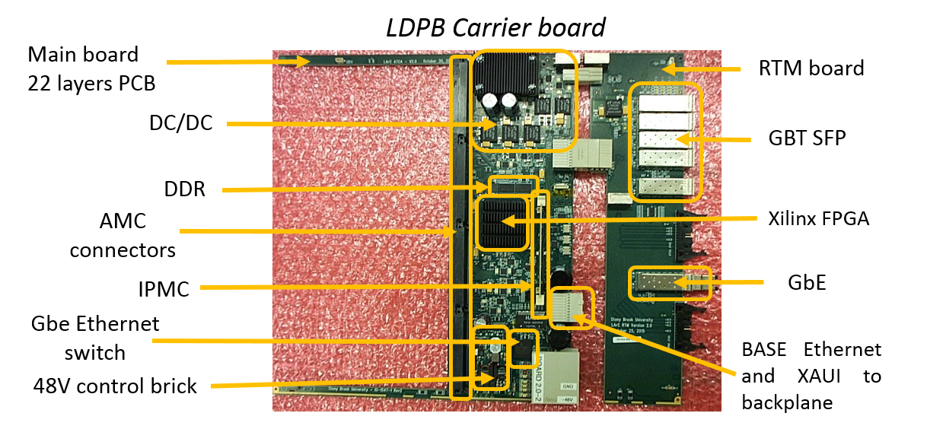
LAr Digital Processing Blade(LDPB)
LDPB: receives digital SC data from the LTDBs of the upgraded FE system, reconstructs E_{T}SC (the transverse energy of each SC), and transmits the results to the Level-1 Calorimeter Trigger System every 25 ns.
Total number of boards:
32 ATCA Carrier board and 128 AMC mezzanine (LATOME) boards
ATCA Carrier board + RTM
Monitoring data through RTM and ATCA
4 LATOME per each Carrier
main data flow only through LATOME
(in: 20 Tbps, out: 41 Tbps in total)
ARRIA10 (Altera) and Virtex7 (Xilinx) FPGAs
192 input fibres @ 5.12 Gbps
192 output fibres @ 11.2 Gbps

Slide 15
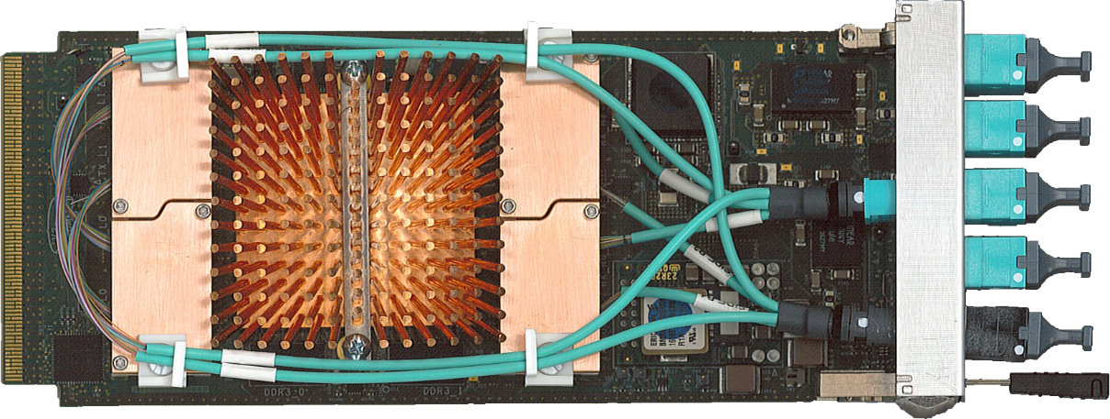
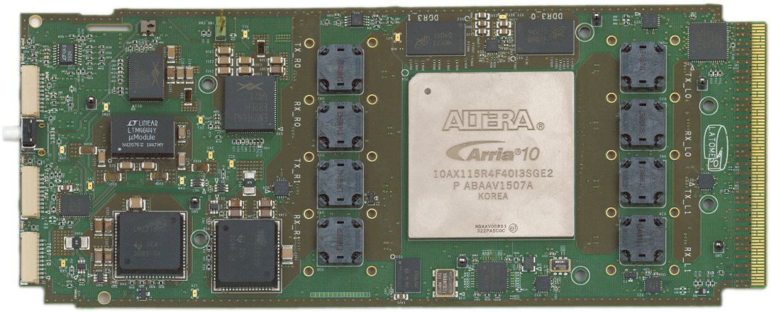
LAr Trigger prOcessing MEzzanine: LATOME
Main data path
Receives Super Cells data from LTDB @5.12 Gbps on up to 48 optical links
Computes Super Cells transverse energy (ET) using optimal filter at each 25 ns bunch crossing
Builds trigger tower transverse energy and assigns it to the correct bunch crossing
Sends trigger tower data @11.2 Gbps on up to 48 optical links
System has fixed latency less than 375 ns
Receives Timing, Trigger Control (TTC) commands and clock and data from the Carrier board
Monitors data and sends report to Central data acquisition system upon request
DC/DC block
2Gbits DDR3 @ 800MHz
8 Avago uPods
(8*12 optical links)
16 layers PCB
AMC interface

Slide 16
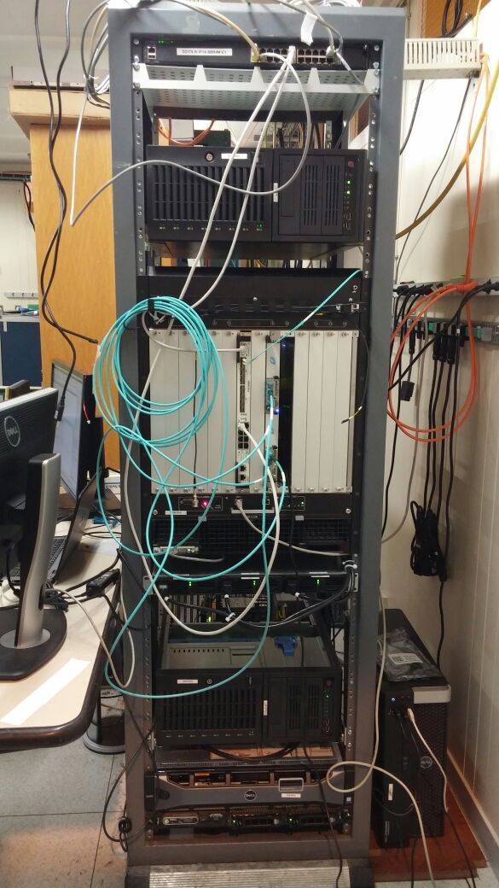
Back End System Test
Build a system with the final prototype
Connect to the real environment @CERN
Timing, Trigger Control commands and clock
Atlas Development Network
Development PCs
First system test done in march 2017
Checks simple configuration
More system tests in Q2 2017
Until fully functional
Purpose
Confirm all functionalities before mass production

Slide 17
Demonstrator

Slide 18
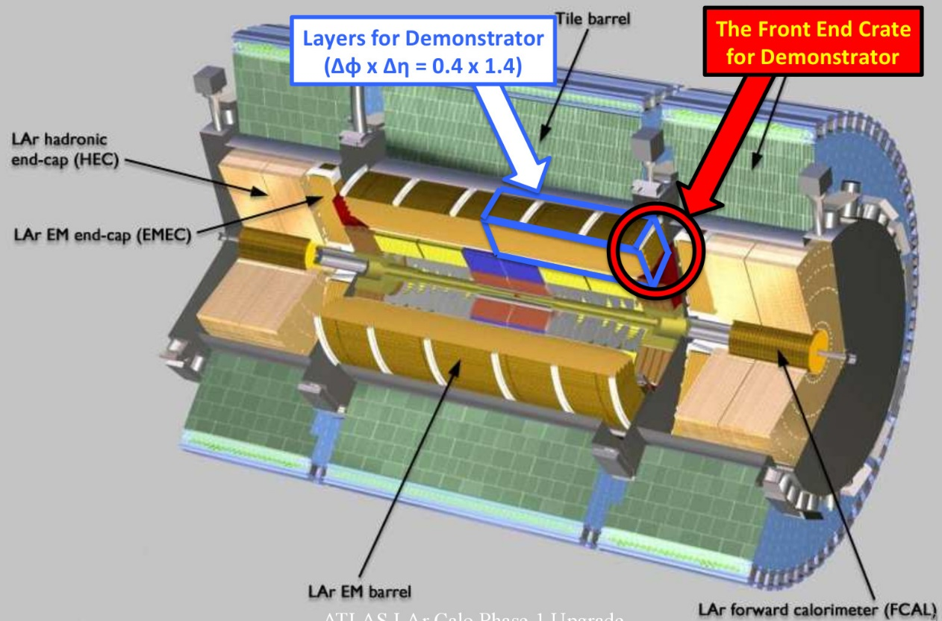
Demonstrator motivations
A demonstrator was installed in ATLAS in the EM barrel (coverage 1/32 of barrel region) in summer 2014 to show the feasibility of the Phase I Upgrade:
Demonstrator FE: 2 LTDBs
Demonstrator BE: 3 (originally 2) ATCA test Board for Baseline Acquisition (ABBA)
Reads data from Super Cells
Validates energy reconstruction and bunch crossing identification and collects real collision data for the filtering algorithm development
Gain experience in installation and operation of such equipment in the ATLAS environment

Slide 19
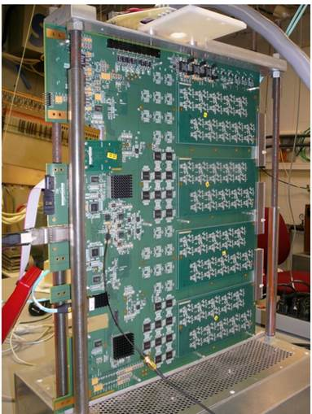
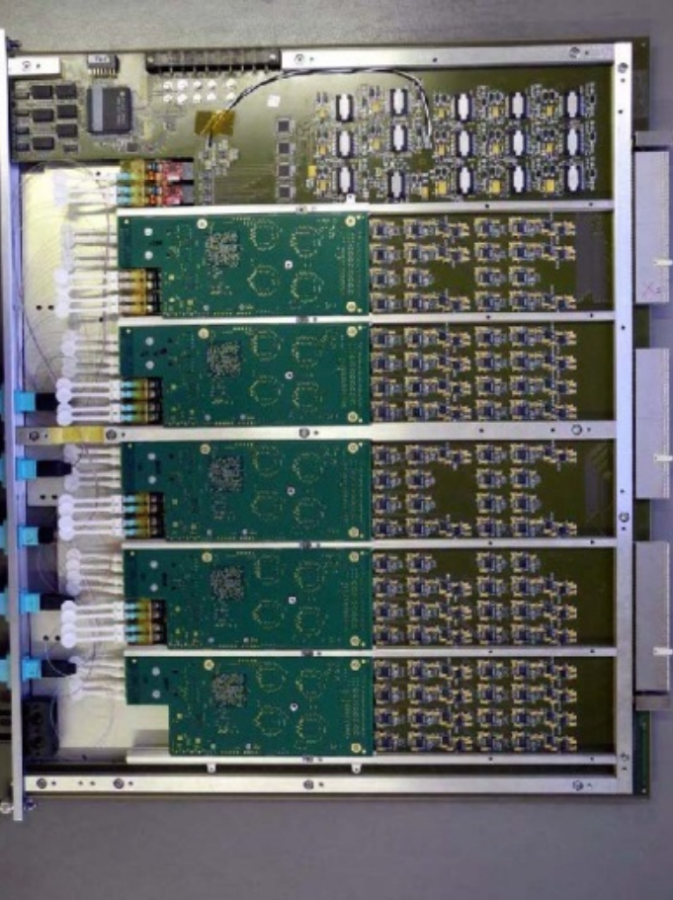
FE Demonstrator: LTDB
Digital Motherboard + analog mezzanines
Handles up to 320 Super Cells signals
284 Super Cells in EM Barrel
Super Cells signals are digitized with 12bits ADC@ 40MHz
Commercial ADC COTS : TI ADS5272 (not radiation tolerant)
Multiplexing 8 Super Cells on one 4.8 Gbps optical link
8B10B encoding, K-code sent every Bunch Crossing revolution
Xilinx FPGAs
48 optical links
Throughput ≈ 200 Gbps/LTDB
Status:
2 LTDB versions developed and installed in August 2014
Taking collision data in LHC Run 2
Analog Motherboard + digital mezzanines

Slide 20
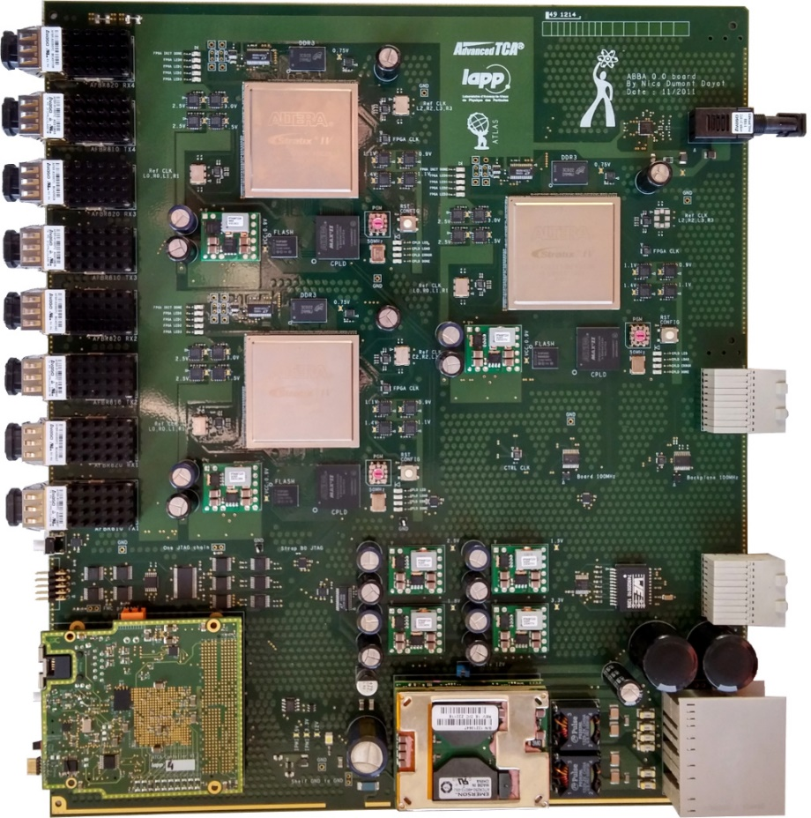
BE Demonstrator: ABBA
Optical links
Altera FPGAs
ATCA board: 3 Altera FPGAs (Stratix IV)
Receives up to 320 Super Cells signals (SC) from one LTDB
Up to 48 optical links @ 4.8Gbps
Stores Super Cells data into circular buffer
Latency up to 2.5us
Waits for Level-1 trigger to readout Super Cells data
Readout using IPbus protocol over UDP on 10 GbE network
Readout with ATCA fabric interface
Status:
3 ABBA boards installed in USA15
Online software operational
Concurrent readout in parallel with ATLAS default readout since October 2015
Since November 2016 integrated in the automated ATLAS data taking
Successful data taking in LHC Run 2
IPMC
DC/DC
16 layers PCB

Slide 21
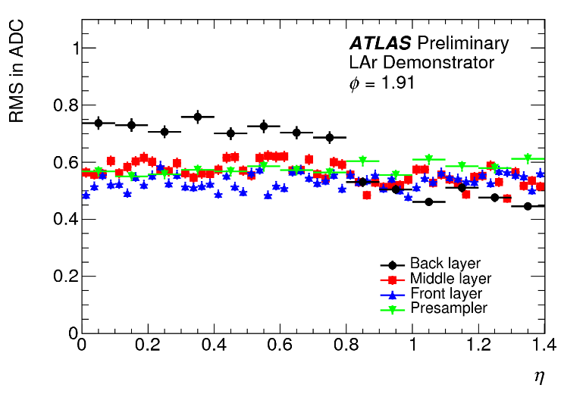
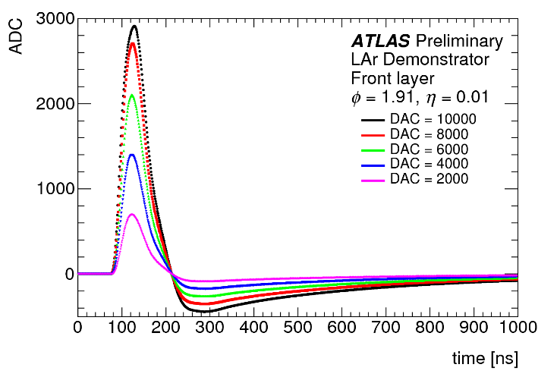
Demonstrator data taking
Noise levels of SCs
Calibration:
electronic pulses sent by calibration board
Collisions (proton-proton and heavy ion):
successful data taking in 2015 and 2016:
collected data triggered in Demonstrator region
in-system debugging of firmware quite successfully
ready for 2017 pp data taking
special Level-1 topological trigger item is used
thanks to the L1 community
compared Demonstrator readout and ATLAS main readout
Calibration pulse shape
Total noise on main readout of calorimeters cells of demonstrator similar to neighboring crates
Plan for early 2018 to have final prototype installed and running in end of Run 2

Slide 22
Summary

Slide 23
Summary
The ATLAS Lar calorimeter electronics will be upgraded for Phase-1 after Long Shutdown 2 (2019-2020)
The trigger path will be digitized at Front-End level with an improved granularity
LTDB and LDPS systems are being developed and produced
Radiation tolerant ADC and Optical links specifically designed
System input data rate is 20Tbps and output data rate is 41 Tbps in total
LTDB prototype being assembled
LDPB ATCA carrier board and LATOME AMC boards being tested
A part of the new Trigger scheme (Demonstrator) has been installed
Both Front End and Back end electronics have been validated
One Front End Crate (1/32) is equipped with the demonstrator
Readout through TDAQ software
Production will start in 2018

Slide 24
Backup slides

Slide 25
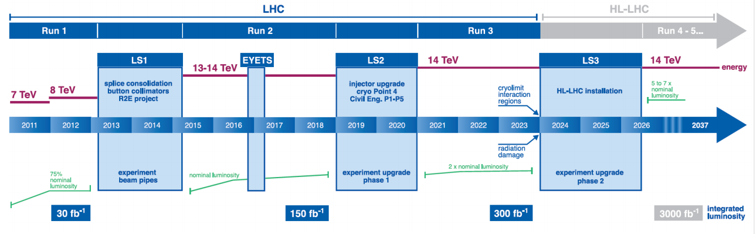
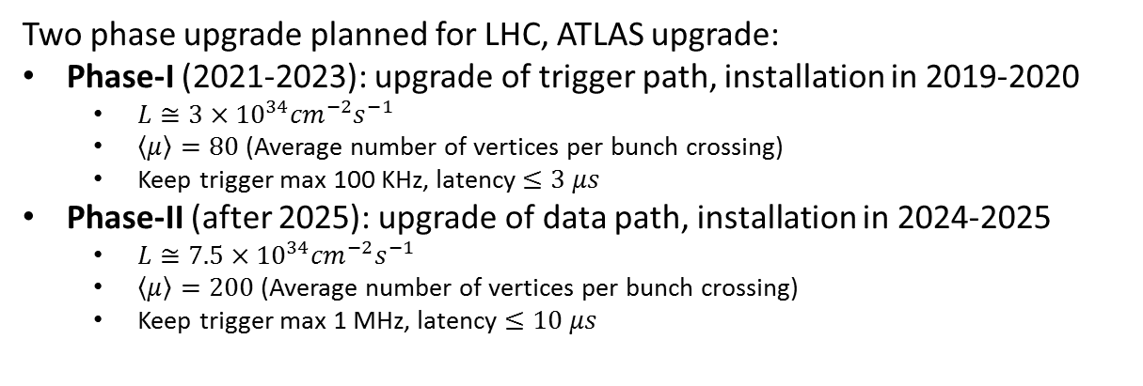
LHC Schedule
Two phase upgrade planned for LHC, ATLAS upgrade:
Phase-I (2021-2023): upgrade of trigger path, installation in 2019-2020
$L≅3×{10}^{34}{cm}^{−2}s^{−1}$
$\left\langle \left.μ\right\rangle \right.=80$ (Average number of vertices per bunch crossing)
Keep trigger max 100 KHz, latency $≤3 μs$
Phase-II (after 2025): upgrade of data path, installation in 2024-2025
$L≅7.5×{10}^{34}{cm}^{−2}s^{−1}$
$\left\langle \left.μ\right\rangle \right.=200$ (Average number of vertices per bunch crossing)
Keep trigger max 1 MHz, latency $≤10 μs$
Upgrade of LAr trigger readout
Upgrade of LAr main readout

Slide 26
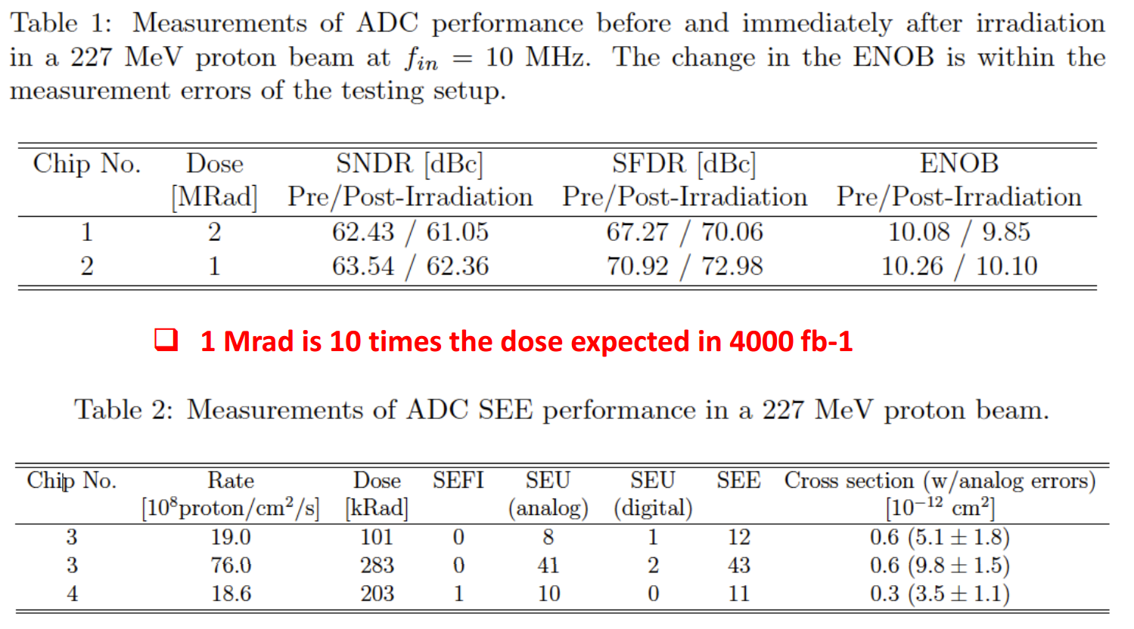
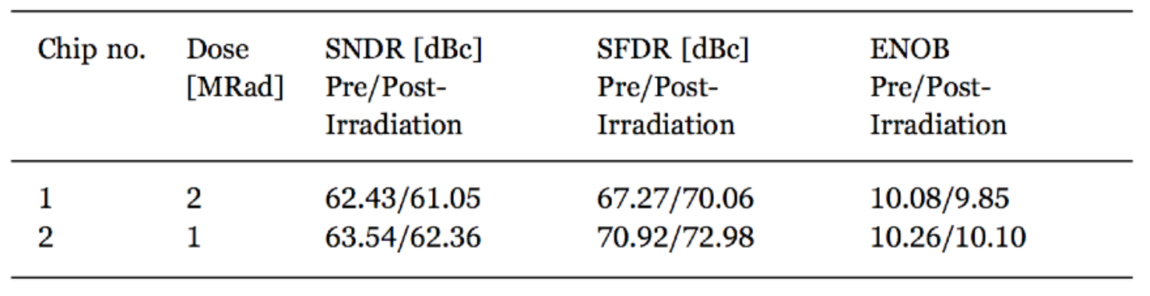
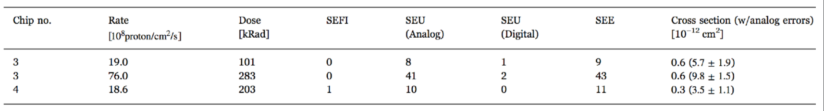
ADC: radiation tolerance
Total Ionizing Dose
Single Event Effect

Slide 27
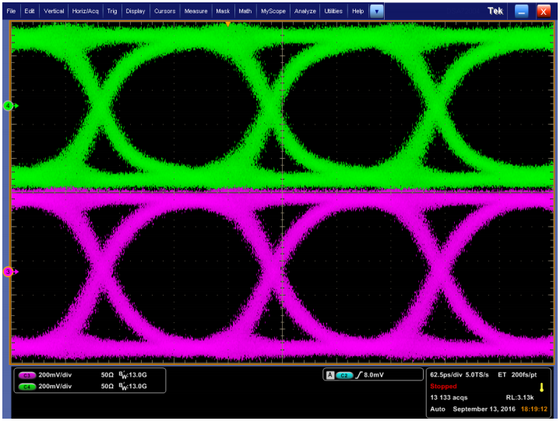
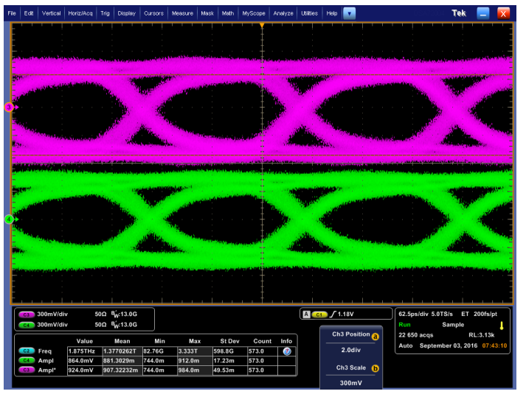
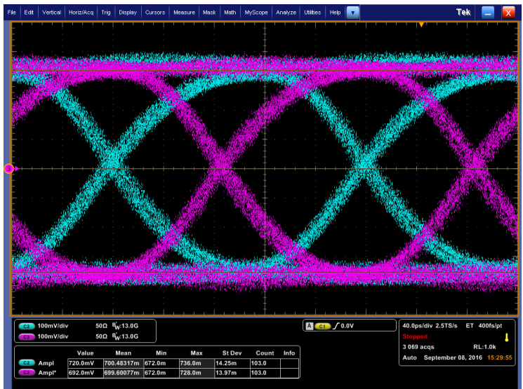
LOCx2 & LOCld: radiation tolerance
LOCx2
Eye Diagram 5.12 Gbps
2 Channels chip soldered on PCB
Total jitter ~ 50 ps (loop filter = 800 kHz)
Eye Diagram after 182 krad TID
Low or high dose rate (3krad/hr or 30 krad/h)
LOCld
No eye diagram change after 200 krad
2 channels shifted for display clarity
Current change after irradiation < 10%

Slide 28
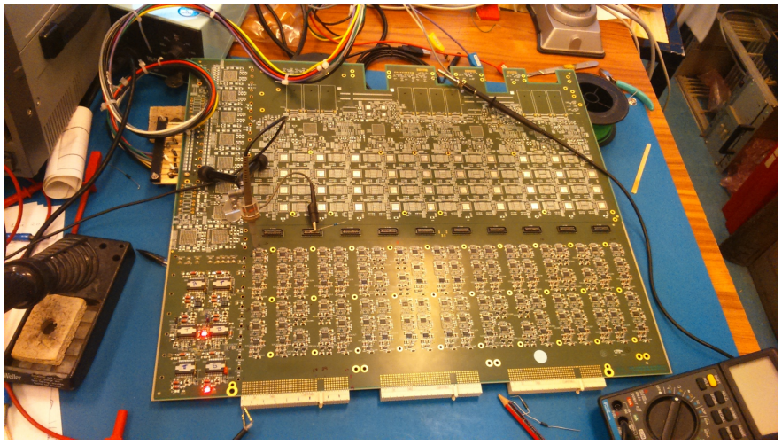
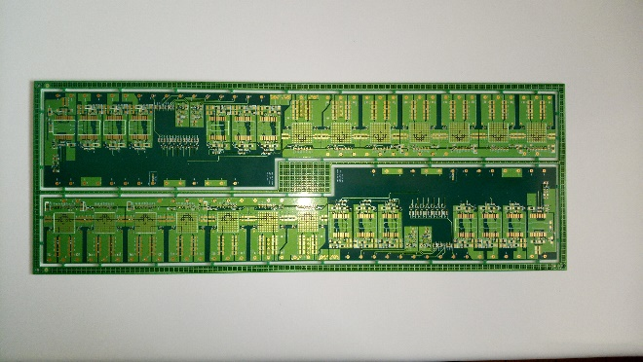
LTDB Development
LTDB pre-prototype 320ch
Pre-prototype PCB
FPGA used to replace LOCx2
LTDB prototype
Analog section and digital section are designed by different institutes, and Gerber merged for fabrication
Power section is realized on a mezzanine
2 LTDB prototypes could be used to replace LTDB demonstrators in January 2018

Slide 29
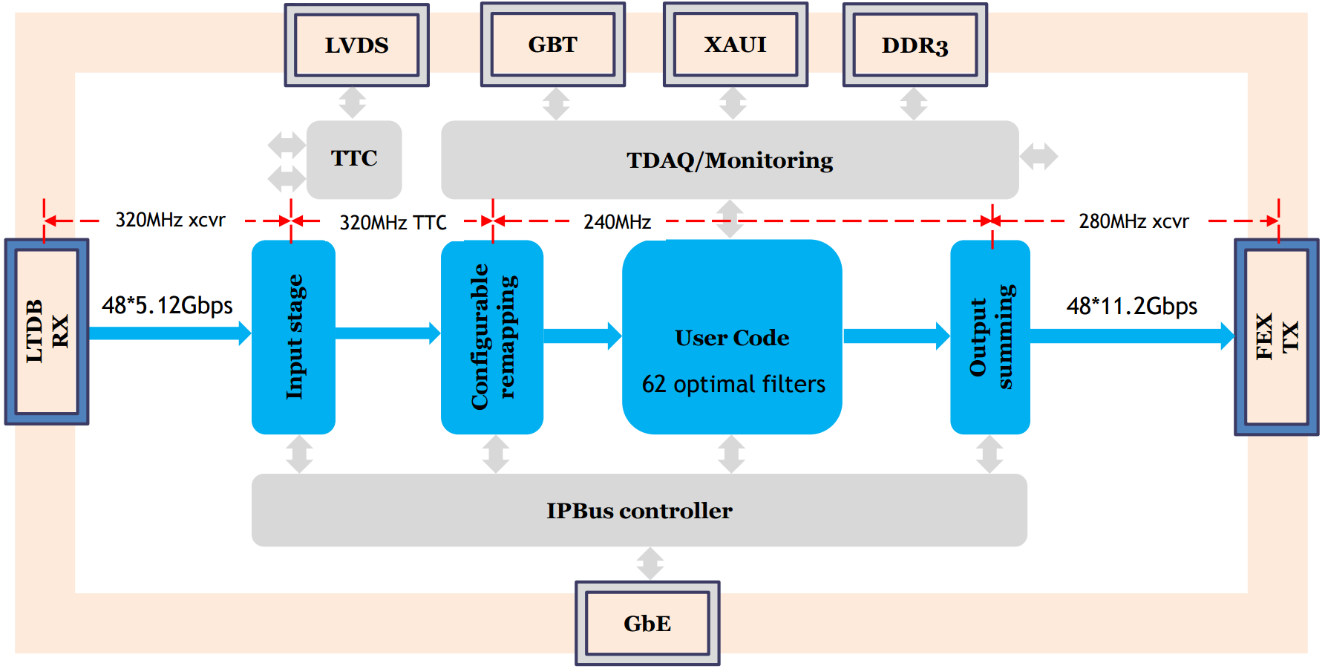
LATOME Firmware
Input stage aligns all inputs to the same BCID
Configurable remapping: reorders input data according to detector’s topology
User Code: computes Et and time using Finite Impulse Response filter (FIR)
Output summing: builds trigger tower energies

Slide 30
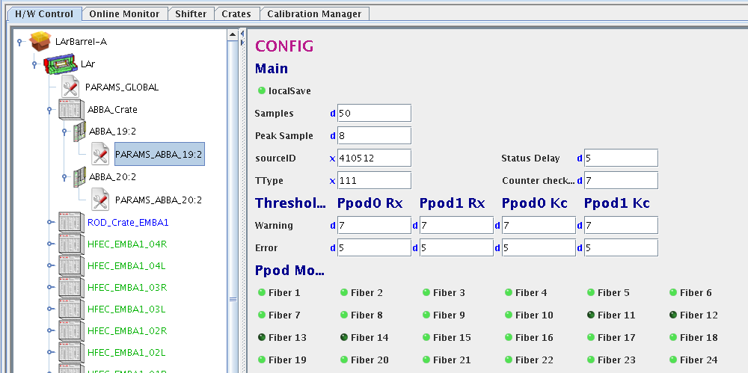
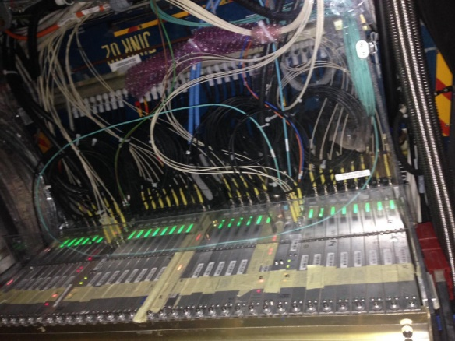
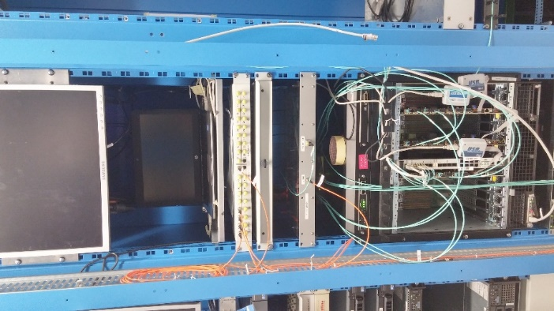
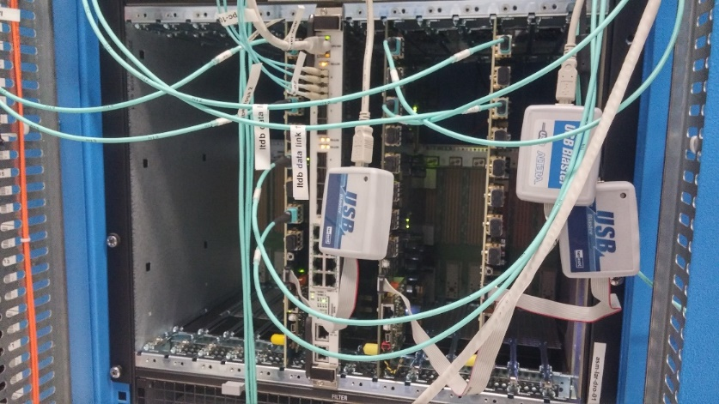
Demonstrator readout in ATLAS
Readout computer (10GbE)
LTDBs in FE crate
ABBAs in ATCA crate
with 10GbE ethernet switch
#1
#2
#3
ATLAS LAr TDAQ software
UX15
USA15

